Slide 1
Structures &Pointers

Slide 2
Structures
Structures (also called structs) are a way to group several related variables into one place. Each variable in the structure is known as a member of the structure.
Unlike an array, a structure can contain many different data types (int, float, char, etc.).
Arrays allow to define type of variables that can hold several data items of the same kind. Similarly structure is another user defined data type available in C that allows to combine data items of different kinds.
Structures are used to represent a record. Suppose you want to keep track of your books in a library. You might want to track the following attributes about each book −
Title
Author
Subject
Book ID

Slide 3
The ,struct keyword is used to define the structure. Let's see the syntax to define the structure in c.
struct structure_name
{
data_type member1;
data_type member2;
.
.
data_type memeberN;
};

Slide 4
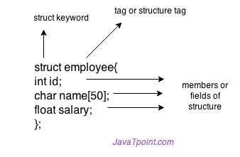
Let's see the example to define a structure for an entity employee in c.
struct employee
{
int id;
char name[20];
float salary;
};
Here, struct is the keyword; employee is the name of the structure; id, name, and salary are the members or fields of the structure. Let's understand it by the diagram given below:

Slide 5
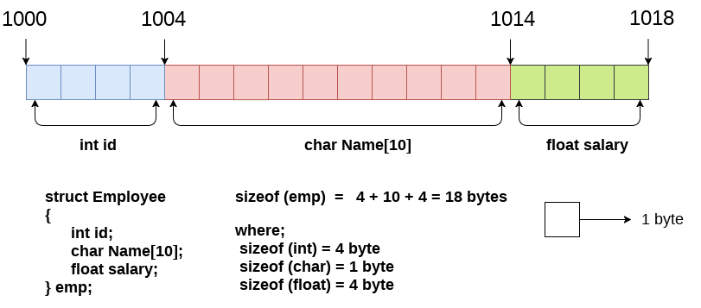
The following image shows the memory allocation of the structure employee that is defined in the above example.

Slide 6
Declaring structure variable
We can declare a variable for the structure so that we can access the member of the structure easily. There are two ways to declare structure variable:
By struct keyword within main() function
By declaring a variable at the time of defining the structure.
1st way:
Let's see the example to declare the structure variable by struct keyword. It should be declared within the main function
struct employee
{ int id;
char name[10];
float salary;
};
Now write given code inside the main() function.
struct employee e1, e2;
The variables e1 and e2 can be used to access the values stored in the structure. Here, e1 and e2 can be treated in the same way as the objects in C++ and Java.

Slide 7
2nd way:
Let's see another way to declare variable at the time of defining the structure.
struct employee
{ int id;
char name[50];
float salary;
}e1,e2;
Accessing members of the structure
There are two ways to access structure members:
By . (member or dot operator)
By -> (structure pointer operator)
Let's see the code to access the id member of p1 variable by. (member) operator.
p1.id

Slide 8
#include<stdio.h>
#include <string.h>
struct employee
{ int id;
char name[50];
}e1; //declaring e1 variable for structure
int main( )
{
//store first employee information
e1.id=101;
strcpy(e1.name, "Sonoo Jaiswal");//copying string into char array
//printing first employee information
printf( "employee 1 id : %d\n", e1.id);
printf( "employee 1 name : %s\n", e1.name);
return 0;
}
o/p:employee 1 id : 101 employee 1 name : Sonoo Jaiswal

Slide 9
C Pointers
The pointer in C language is a variable which stores the address of another variable. This variable can be of type int, char, array, function, or any other pointer. The size of the pointer depends on the architecture. However, in 32-bit architecture the size of a pointer is 2 byte.
Consider the following example to define a pointer which stores the address of an integer.
int n = 10;
int* p = &n; // Variable p of type pointer is pointing to the address of the variable n of type integer.
Declaring a pointer
The pointer in c language can be declared using * (asterisk symbol). It is also known as indirection pointer used to dereference a pointer.
int *a;//pointer to int
char *c;//pointer to char

Slide 10
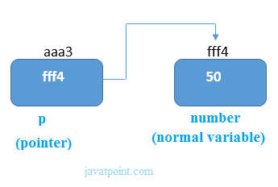
Pointer Example
As you can see in the above figure, pointer variable stores the address of number variable, i.e., fff4. The value of number variable is 50. But the address of pointer variable p is aaa3.
#include<stdio.h>
int main(){
int number=50;
int *p;
p=&number;//stores the address of number variable
printf("Address of p variable is %x \n",p); // p contains the address of the number therefore printing p gives the address of number.
printf("Value of p variable is %d \n",*p); // As we know that * is used to dereference a pointer therefore if we print *p, we will get the value stored at the address contained by p.
return 0;
}

Slide 11
Pointer to array
int arr[10];
int *p[10]=&arr; // Variable p of type pointer is pointing to the address of an integer array arr.
Pointer to a function
void show (int);
void(*p)(int) = &display; // Pointer p is pointing to the address of a function
Pointer to structure
struct st {
int i;
float f;
}ref;
struct st *p = &ref;

